Slide 1
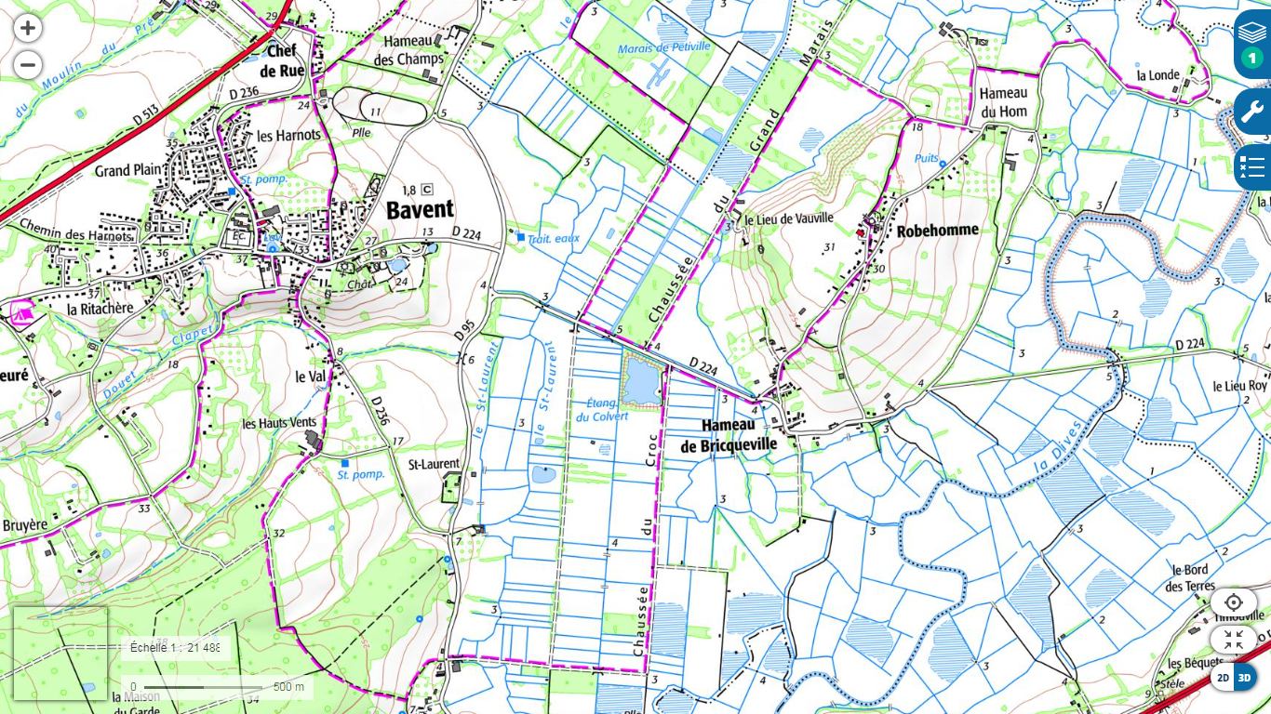
D/A parking Eglise Bavent

